Slide 1

Driver Behavior Assessment and Designing Advanced Driver Assistance Systems (ADAS) for two-wheeler drivers
Mentor:
Dr. Manish Chaturvedi
Mihir Vangani (201020011021)
Kunj Patel (201020011020)

Slide 2
Title
Our project is centered around enhancing road safety by utilizing vehicular and physiological sensors to evaluate a driver's behavior while operating a two-wheeler.
We collect extensive sensor data and channel it into a sophisticated machine learning model.
This AI model leverages classification and neural networks to predict a driver's behavior and driving patterns.
The Advanced Driver Assistance Systems (ADAS) developed for two-wheelers offer real-time support to the driver.
They not only assess behavior but also provide immediate feedback and valuable suggestions for improving driving patterns.

Slide 3
Why
The Indian two-wheeler market size reached a volume of 18 Million Units in 2022.
NCRB reports says that 1,55,622 people died in road accident in 2021 out of which nearly 70,000 people are driving two-wheelers.
The highest numbers of deaths in road accidents were reported on the National Highways.
There are many reasons for accidents like Blind spots, over speeding, Distracted Driving, and frequent lane changing.

Slide 4
Existing Solutions
1. Making applications to collect data
Developers are diligently crafting applications for smartwatches and Smartphones. The primary objective of this symbiotic software ecosystem is to seamlessly collect and relay sensor data from smartwatches to their paired mobile applications.
Data will transfer from smart watch to smart phone using Bluetooth technology.
This method will work if our watch Operating System give access to developers.
Some operating system are open for developers to work on there OS like
Google Wear-OS
Samsung Tizen
Wasp-OS

Slide 5
Existing Solutions
2. Making own hardware
People are making hardware for four wheelers. Signals are obtained from GPS data logging systems. These signals include information such as speed, acceleration, and steering angle.
The system uses the processed GPS data to diagnose driving behavior. It evaluates driver actions, such as steering and pedal handling, speeding, and deviations from lanes and roads.
AI model will classify drivers as either moderate or aggressive based on their behavior.
It distinguishes between different drivers using neural network algorithms, allowing it to recognize specific individuals.
This system promptly displays accident-prone road segments. This feature offers critical insights into road conditions.

Slide 6
Existing Solutions
3. Wasp-OS
Wasp-OS is an open-source Development based on micro python libraries. A simple and easy-to-use smartwatch operating system for the PineTime smartwatch.
Wasp OS supports the development of custom apps using Micro Python. This allows you to create apps for your smartwatch.
Wasp OS supports a variety of sensors, including accelerometers, gyroscopes, and heart rate monitors. You can use Wasp OS to collect sensor data and store it on the smartwatch, or send it to a remote server for further processing
We can use the MicroPython network module to send the data over HTTP or MQTT.

Slide 7
Our Work
We are making an Advanced Driving Assisting System(ADAS) for two-wheeler drivers. We have applied different approaches to achieve our goal.
We are using Smart Watch to take Raw sensor data. We are collecting photoplethysmography, Accelerometer, and gyroscope data from Watch.
We are also making one application for smartphones that will collect data. This application has machine learning algorithm which will tell us about driving behavior.
Smart Watch and smartphone relates to Bluetooth technology. The application collects data from the smartwatch and stores this data in a CSV file.
Classification Algorithm will take this data and process it. It will tell driving patterns, road conditions, and blind spots.

Slide 8
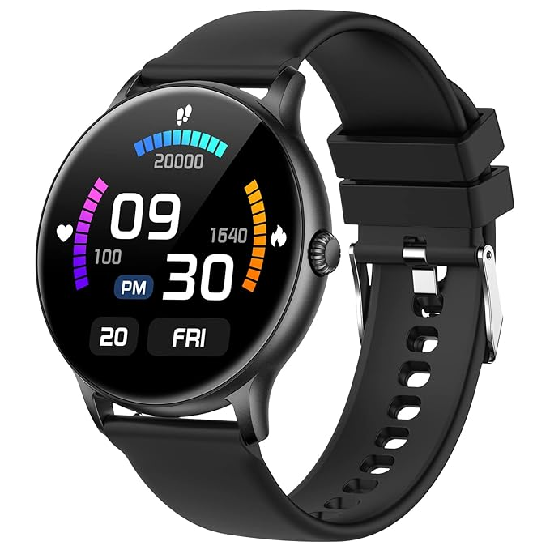
Smartwatch
We are using Fire-Boltt Phoenix Smart Watch.
It has HRS 3300 Sensor that can measure heart rate and blood oxygen levels with high accuracy.
It has Optical heart rate sensor to measure heart rate and SpO2 in blood.
The HRS3300 sensor is able to measure heart rate and movement accurately, even during sleep. shows how much time you spend in each sleep stage and how your heart rate and movement change throughout the night.

Slide 9
Methodology

Slide 10
Data Collection:

Slide 11
Results:

Slide 12
Challenges and Limitations:

Slide 13
Future Work:

Slide 14
Conclusion:

Slide 15
References:
• e Arriba-Pérez F, Caeiro-Rodríguez M, Santos-Gago JM, "Collection and Processing of Data from Wrist Wearable Devices in Heterogeneous and Multiple-User Scenarios" doi: 10.3390/s16091538. PMID: 27657081.
• C. G. Quintero M., J. O. López, and A. C. Cuervo Pinilla, "Driver behavior classification model based on an intelligent driving diagnosis system," 2012 15th International IEEE Conference on Intelligent Transportation Systems, Anchorage, AK, USA, 2012, pp. 894-899, doi: 10.1109/ITSC.2012.6338727.
• Huang, E. and Onnela, J.P., 2019. "Activity Classification Using Smartphone Gyroscope and Accelerometer Data". arXiv preprint arXiv:1903.12616.
• Quiroz, Juan C. and Yong, Min Hooi and Geangu, Elena, "EmotionRecognition Using Smart Watch Accelerometer" doi: 10.1145/ 3123024.3125614.
• John A, Nundy KK, Cardiff B, John D. "SomnNET: An SpO2 Based Deep Learning Network for Sleep Apnea Detection in Smartwatches. Annu Int Conf IEEE Eng Med Biol Soc. 2021 Nov;2021:1961- 1964. doi: 10.1109/EMBC46164.2021.9631037. PMID: 34891671.
• "DaFlasher app", https://github.com/atc1441/DaFlasherFiles.git.
• "Wasp-Os" https://github.com/wasp-os/wasp-os.git

Slide 16
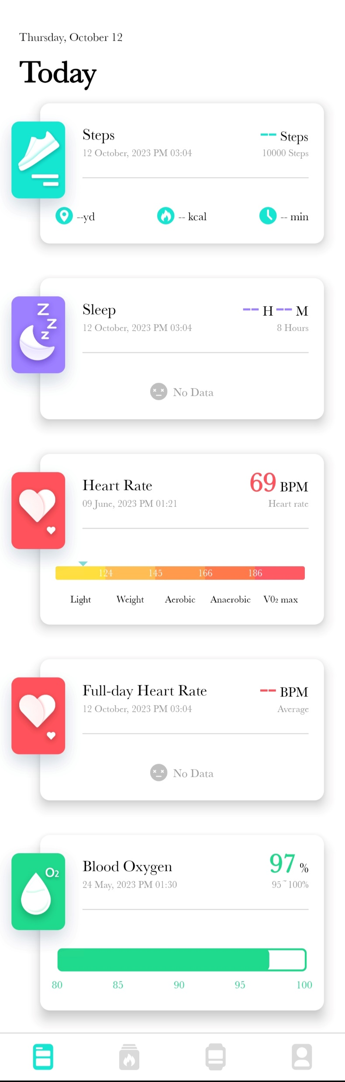
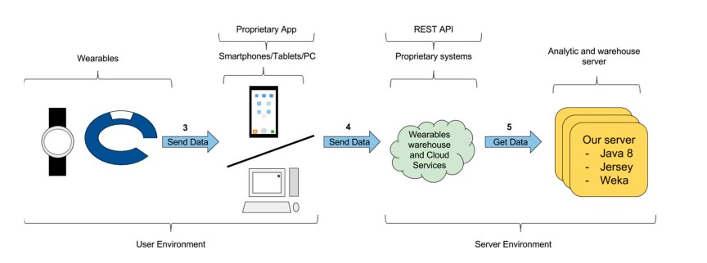
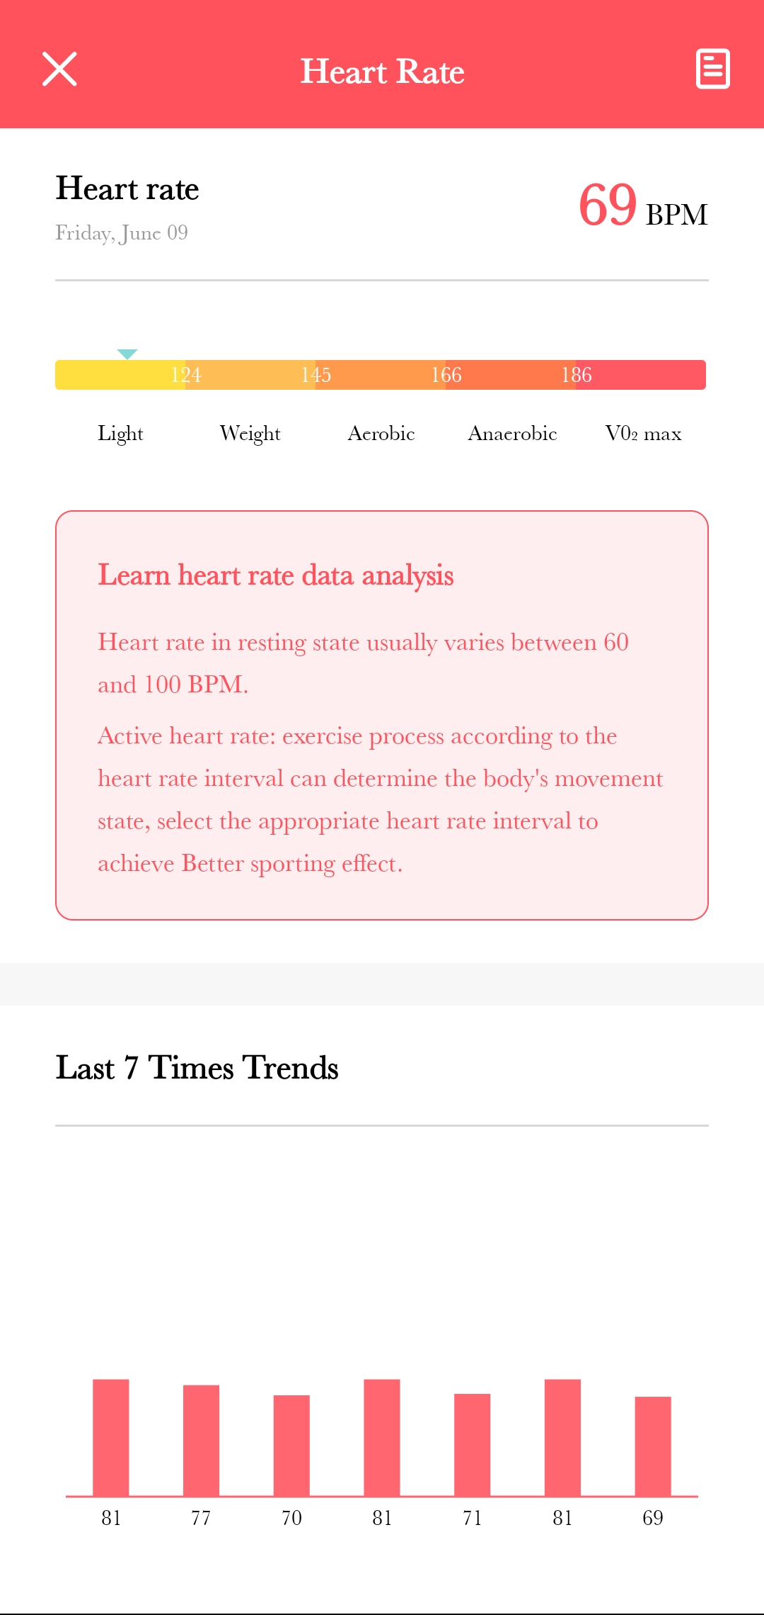
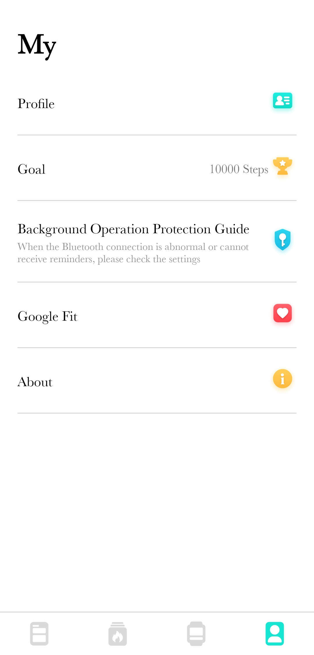
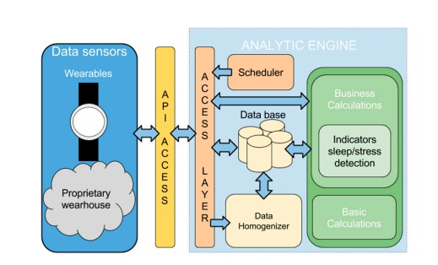

Slide 17
